Slide 1
Insights of “Atliq Hardwares” in Consumer Goods Domain

Slide 2
Insights:
I am presenting insights of “Atliq Hardwares” in consumer goods domain. In 2020, number of unique products was 51 which became 68 in the year of 2021 with the increment of 33.33%. Unique product count by segment shows Accessories and peripherals has highest numbers of unique products (20 nos) while networking has least number of products (3 nos) in their store. The lowest manufacturing cost is 0.8920 for product name as AQ Master wired x1, while AQ HOME Allin 1 gen 2 is the costliest when it comes to manufacturing cost. Flipkart as a customer gets highest discounts and its 0.38. Gross sales amounts says January 2020 has a highest sales and March 2020 has lowest sales with only 57.17. When it comes to quarter wise, fourth quarter of year has highest sales and first quarter remain subdued. When you compare sales channel wise you can see retailer has highest gross sales with staggering number of 1924.17 million which is around 74% of whole sale.

Slide 3
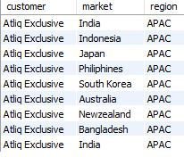
Question:
Provide the list of markets in which customer "Atliq Exclusive" operates its business in the APAC region.
Output:

Slide 4

Question:
What is the percentage of unique product increase in 2021 vs. 2020? The final output contains these fields: unique_products_2020 , unique_products_2021 , percentage change
Output:

Slide 5
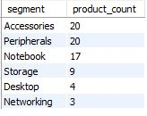
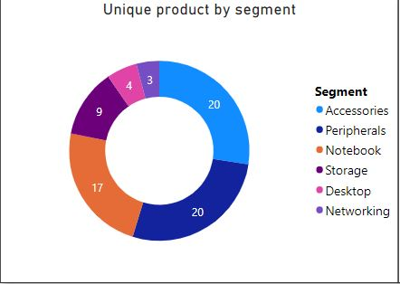
Question:
Provide a report with all the unique product counts for each segment and sort them in descending order of product counts. The final output contains 2 fields: segment and Product count.
Output:

Slide 6

Question:
Get the products that have the highest and lowest manufacturing costs. The final output should contain these fields: product code, product , manufacturing cost.
Output:

Slide 7
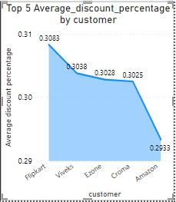
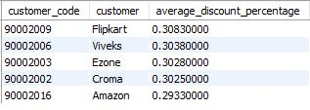
Question:
Generate a report which contains the top 5 customers who received an average high pre invoice discount percentage for the fiscal year 2021 and in the Indian market. The final output contains these fields: customer code, customer, average discount Percentage .
Output:

Slide 8
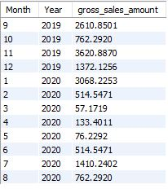
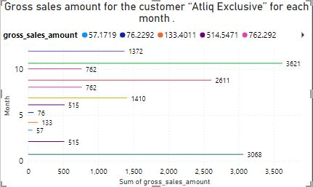
Question:
Get the complete report of the Gross sales amount for the customer “Atliq Exclusive” for each month . This analysis helps to get an idea of low and high-performing months and take strategic decisions. The final report contains these columns: Month, Year, Gross sales Amount.
Output:

Slide 9
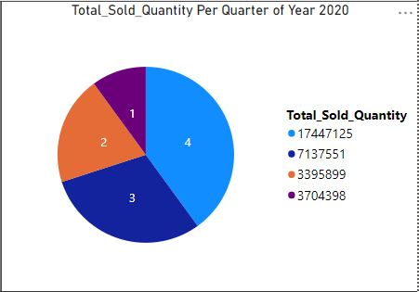

Question:
In which quarter of 2020 got the maximum total sold quantity? The final output contains these fields sorted by the total sold quantity, Quarter, total sold quantity.
Output:

Slide 10
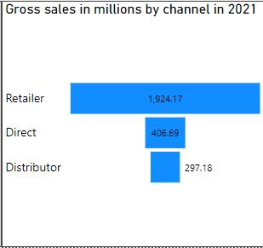

Question:
Which channel helped to bring more gross sales in the fiscal year 2021 and the percentage of contribution? The final output contains these fields: channel, gross sales in million, percentage.
Output:

Slide 11
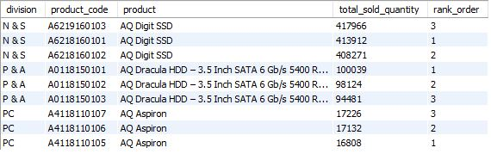
Question:
Get the Top 3 products in each division that have a high total sold quantity in the fiscal year 2021? The final output contains these fields: division, product code
Output:

Slide 12
